Slide 1
Jupyter Notebooks
KROLL BOND RATING AGENCY, INC

Slide 2
Agenda
Pete
Introduction
Basics
Interface
Cell Operations
Markdown
Headings
Bullets
New Lines
Quoted Text
Exporting
ipynb
HTML
Pete - continued
Raw
Button
Image
SQL Example
Libraries
Code – SQL
Output – table
Narrative Description

Slide 3
Cheat sheet
Green Cell – ready to edit code
Enter – new line
Shift + Enter – execute and move
Ctrl + Enter – execute and stay
Escape – leave edit cell mode
Blue Cell –ready to edit notebook
<enter> - switch to editing cell
A - add cell above
B – add cell below
M – make cell Markdown
X – remove cell

Slide 4
Code Snippet – Show/Hide Input
<script>
function code_toggle() {
if (code_shown){
$('div.input').hide('500');
$('#toggleButton').val('Show Code')
} else {
$('div.input').show('500');
$('#toggleButton').val('Hide Code')
}
code_shown = !code_shown
}
$( document ).ready(function(){
code_shown=false;
$('div.input').hide()
});
</script>
<form action="javascript:code_toggle()"><input type="submit" id="toggleButton" value="Show Code"></form>

Slide 5
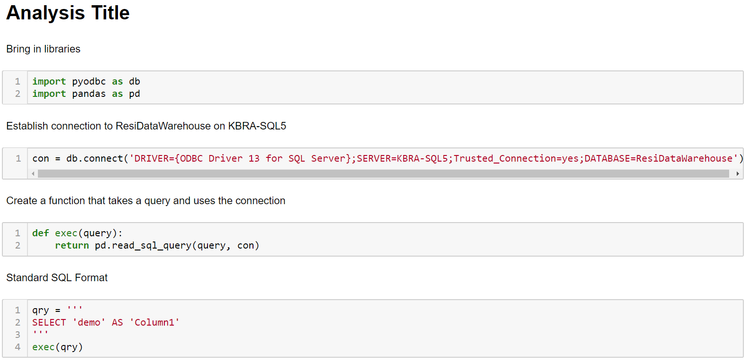
SQL Template
<script>

